Slide 1

How Community Power Works
SOURCE | DELIVERY | COMMUNITY
Concord Community Power purchases electricity from the sources you choose. | Unitil delivers the electricity using the same power line infrastructure and billing mechanisms. | Concord Energy Customers save money and have the power to choose new rates and products, and how much electricity comes from renewable sources.

Slide 2
How Community Power Works
Concord Community Power combines the buying power of residents and businesses so that together we can achieve competitively priced electricity:​
          In advance of the launch of Concord Community Power, all customers within the Town have been mailed a notice (containing information about their electricity rates and energy supply choice options).​​
All customers have at least until the date when Concord Community Power launches to consider whether to opt-out, opt-in, or opt-up to choose a cleaner power option:
  Most customers currently on Unitil default supply service are automatically enrolled into our lower electricity rate: unless they opt-out, customers begin taking service from Concord Community Power on the date Unitil reads their meter.
  On your Unitil bill, the ‘Supplier’ line item will read “Community Power.”
  Select customer groups are not eligible for automatic enrollment but may choose to opt-in.
After the launch of Concord Community Power, customers are always free to choose to buy power from Unitil, or from another market option, by submitting notice in advance of their next utility meter read date.

Slide 3
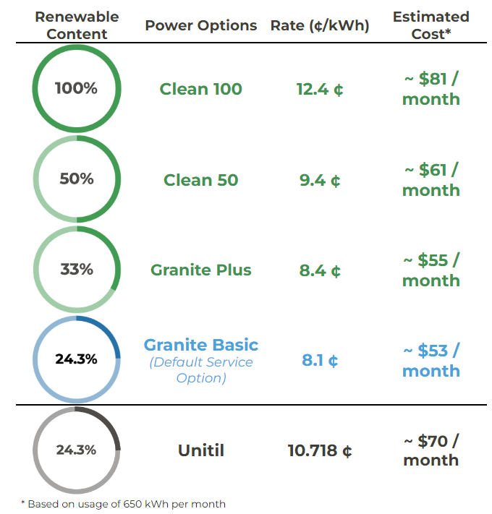
Electricity Choices
February 1, 2024 - July 31, 2024
Energy customers can select from a menu of energy choices.
Visit CommunityPowerNH.gov and use the portal, or call 1-866-603-POWR, to select your power option.
Please have your utility account number handy so your selection may be easily processed.
Customers are always free to choose to buy power from their utility, or from another market option, without charge.
* Based on usage of 650 kWh per month
Notes:
SSS

Slide 4
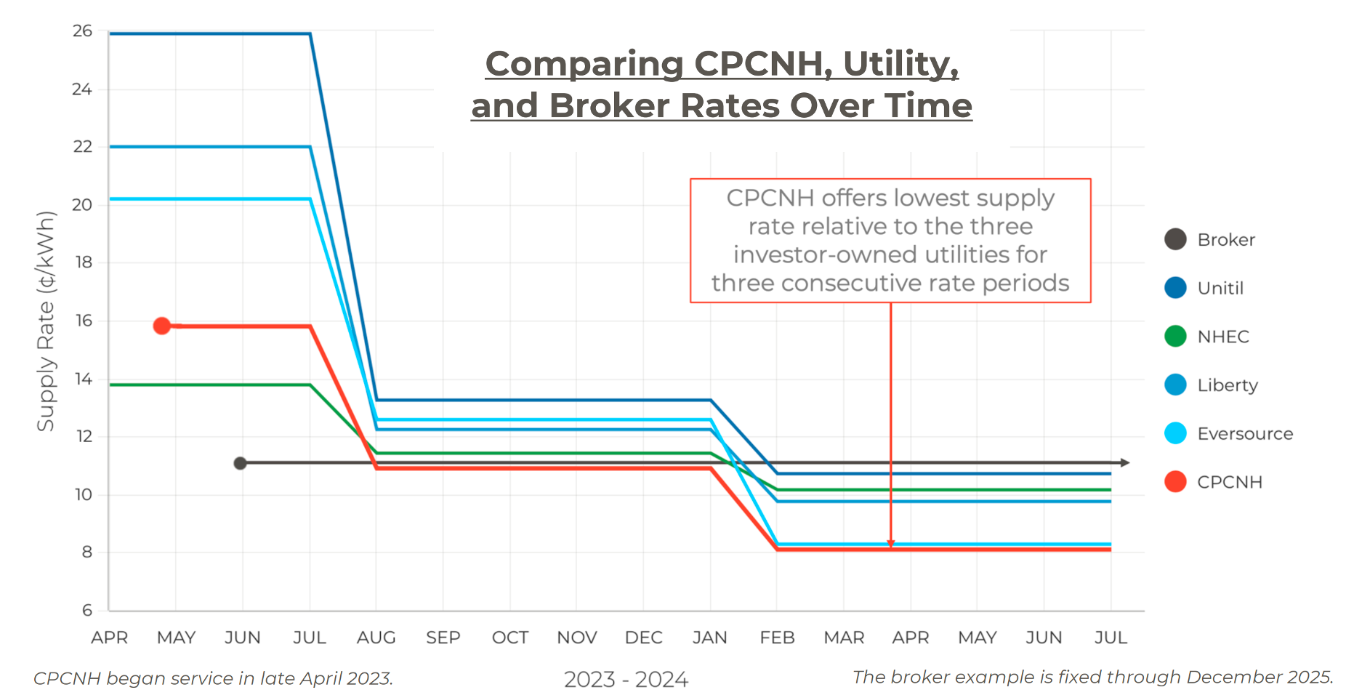
Rate Comparison: Community Power & Utilities
Community Power has flexibility: active power portfolio mgmt.; adjust rates to maintain discounts; deposit net revenues into community reserve funds for long term price stability and public benefit.
Feb-Jul rates dropping by 32%
Until rate includes a 2.618 ₵/kWh remittance for a prior rate over-collection, but is still more expensive than Community Power
Concord’s failure to launch as part of wave 1 will cost members of the community over $6 million in above market electric bills over the course of the past year

Slide 5
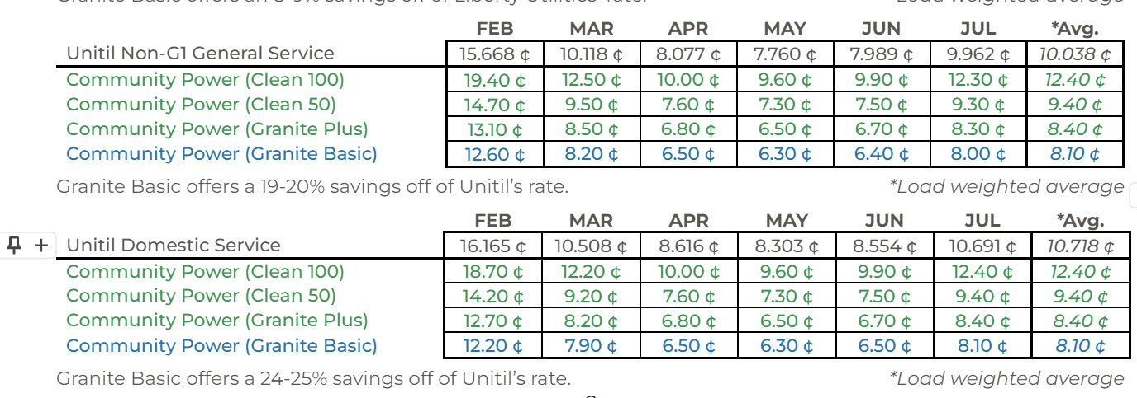
Commercial Rates
Granite Basic offers a 32-33% savings off of Unitil’s rate. *Load weighted average = 8.1 ¢/kWh
Notes:
SSS

Slide 6
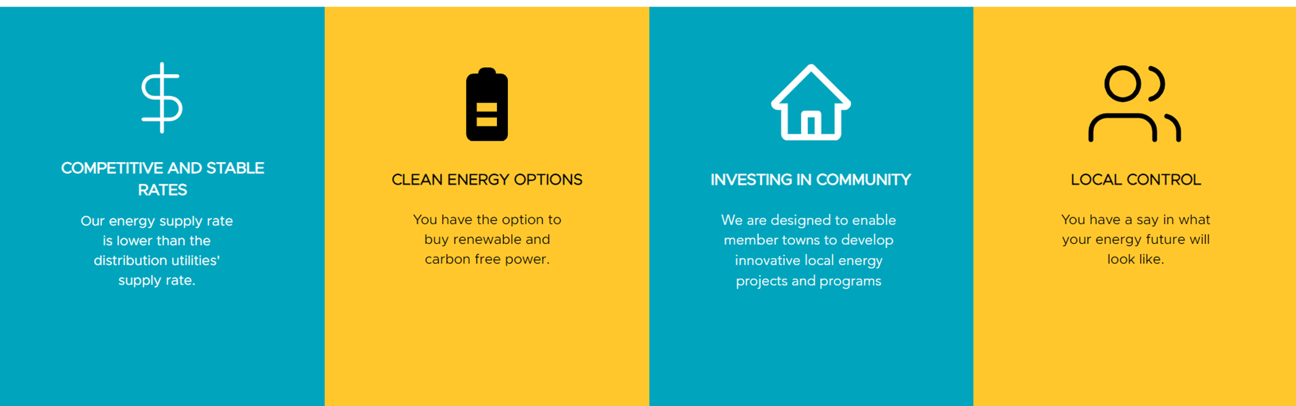
Long-term Benefits

Slide 7

Community Representation
Concord will vote to join 50+ other cities and towns to create our own locally accountable nonprofit power agency: Community Power Coalition of NH.
As a Member of the Coalition, the Town of Concord has representation in guiding the Coalition’s decision-making and participates in electing the Board of Directors.

Slide 8
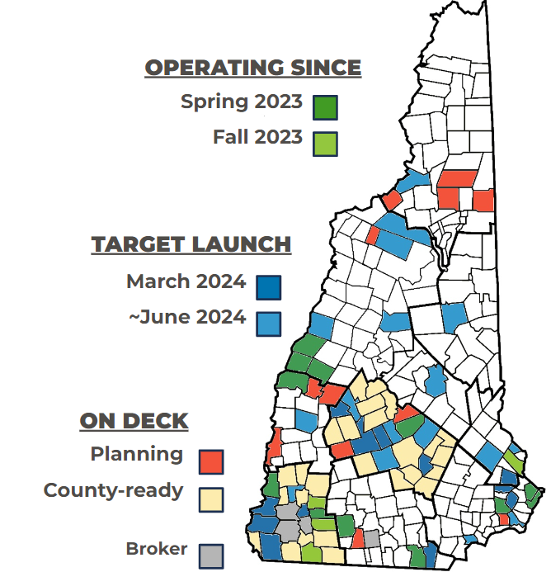
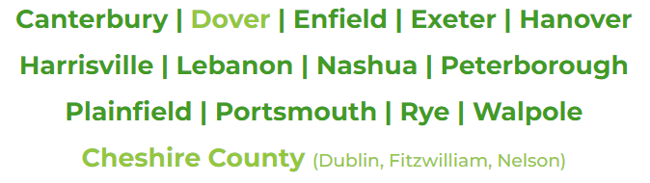
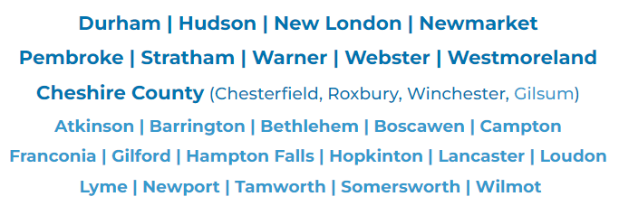
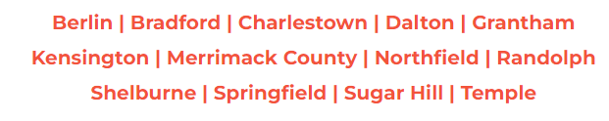
Community Power Coalition of New Hampshire
Nonprofit electricity supplier created by NH cities & towns

Slide 9
Customers Ineligible for Automatic Enrollment
Certain identified customer groups will NOT be automatically enrolled in Concord Community Power, including:
    Customers buying electricity from a third-party supplier.
    Net Metered customers.
    For customers in Unitil's territory: Large General Service, Backup Service, and Commercial & Industrial electric vehicle charging station customers (Rate Classes LG, B EV-2).
If one of these exceptions applies to you and you want to learn more, contact us at info@CommunityPowerNH.gov or by calling 1-866-603-POWR.

Slide 10
Net Metered Customers
Net Metering Customers identified by the distribution utility will NOT be automatically enrolled in Community Power (which should be all of them).
      ○If you are a net metered customer, please contact us at info@communitypowernh.gov or 1-866-603-POWR to verify that your net metered account has been identified by the distribution utility.
What is preventing Net Metering customers from joining Community Power?
○Utilities have not put in place processes to bill and track supply credits for exported power from Net Metering customers
○Utilities are not yet providing monthly export data needed to serve those customers
Net Metered customers who elect to opt-in to Community Power will no longer receive any credits as an offset for supply for the electricity that they generate in addition to their usage each month, until the issues with utilities are resolved.
○Distribution utilities will continue provide delivery credits (distribution, transmission, etc.) for excess generation for Net Metering customers opting into Community Power..
The Coalition is engaging with the NH Public Utilities Commission to resolve this issue and bring utilities into compliance with NH law and regulatory rules.
○When utilities provide the necessary data and billing services, Community Power will offer Net Metering rates and terms to compensate or credit customers for the electricity supply component of their surplus generation and expand offerings to encourage adoption of distributed generation and storage.​
Notes:
Can Net Metered customers choose to be enrolled in Community Power?
Net Metered customers may still elect to opt-in and be served by Community Power programs, but will no longer receive any credit as an offset for supply for the electricity that they generate in excess of their usage each month. (Customers would continue to receive credits as an offset for transmission and distribution services charges from their utility, but not as an offset for supply from the Community Power program.) This may not be a problem for customers that do not generate electricity in excess of their usage in any month. However, customers that do generate electricity in excess of their onsite usage may or may not financially benefit from taking service from Community Power programs. We recommend that Net Metered customers compare the supply rate savings from a joining Community Power program against the impact of foregoing any net metering credit for supply charges before making their decision. If you are a Net Metered customer, please call us at 1-866-603-POWR to discuss your options.

Slide 11
Key Points
Most Unitil default electric supply customers will be automatically enrolled on or after their last meter read in the same service for a lower price. Concord Community Power will be the new default electricity supplier for Concord customers.
Participation in Community Power is voluntary. Customers may opt-out prior to or after enrollment and choose to stay with Unitil for electric supply, or shop for another market option.
Unitil will continue to deliver electricity using their poles and wires, provide billing services, and ensure reliability.
Customers shopping with third-party suppliers will remain with their supplier unless they choose to opt-in to Concord Community Power
Concord Community Power is self-funded by rates paid by participating customers. No taxes will be used to cover program expenses.

Slide 12

Questions & Answers
1-866-603-POWR
info@CommunityPowerNH.gov
CommunityPowerNH.gov
Interested in supporting efforts to remove policy and regulatory barriers to developing local energy projects that lower costs and benefit our local economy?
Join our Community Leader Subscribers List at www.cpcnh.org/community-leader-sign-up

